Slide 1

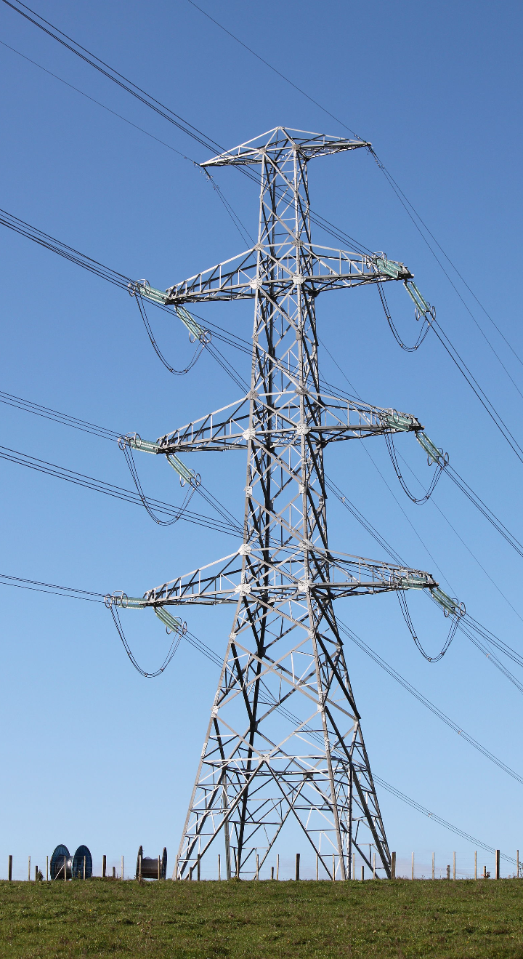
Optimizing Electricity Demand: A Data-Driven Approach
Vishnu Charugundla
Lekhith Reddy Kambham
Likhith Kolli
Prathyusha Murala
Austin Rodrigues

Slide 2


The Challenge of Global Warming
Understanding the risks and anticipating the impact on energy demand, proactive measures must be taken to ensure a resilient energy grid that can withstand the effects of global warming.

Slide 3

Project Objectives
1
Understanding Impact
2
Mitigating Blackouts
3
Avoiding New Power Plants
Assess the impact of global warming on electricity demand to inform future strategies
Reduce energy usage to mitigate potential blackouts and avoid the need for new power plants
Avoid building new facilities
Cut energy usage during hot summer to meet demands

Slide 4

Energy Demand
1
Identifying Approaches
Identify potential approaches to reduce peak energy demand and optimize energy usage
2
Data-driven Recommendations
Develop data-driven recommendations to minimize strain on the grid and enhance sustainability

Slide 5
Data Overview
Static House Data
Energy Usage Data
Basic information on 5,000 houses to understand energy consumption patterns
Hourly usage profiles for each house to analyze energy consumption trends
Metadata
Weather Data
Description of attributes in housing data for comprehensive analysis
Hourly weather information for nearly 50 counties to understand weather-related energy demands

Slide 6
VISUALIZATIONS

Slide 7
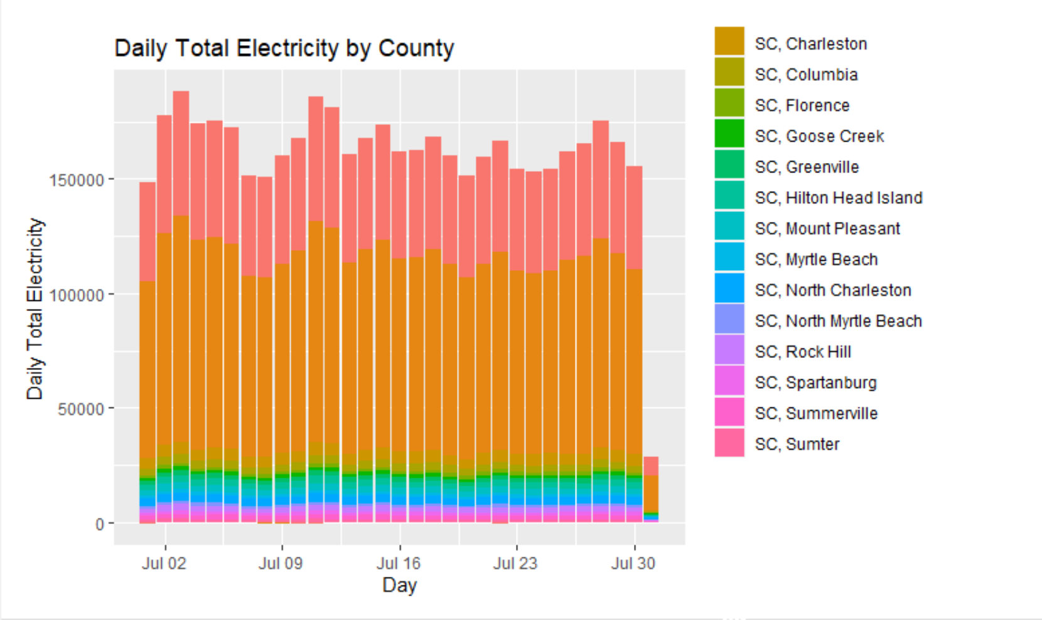
Total Electricity Consumption per Day x County
The graph shows the daily total electricity by county in South Carolina.
Sumter County has the highest total electricity consumption, followed by Charleston County and Columbia County.
The graph shows the daily total electricity by county in South Carolina.

Slide 8
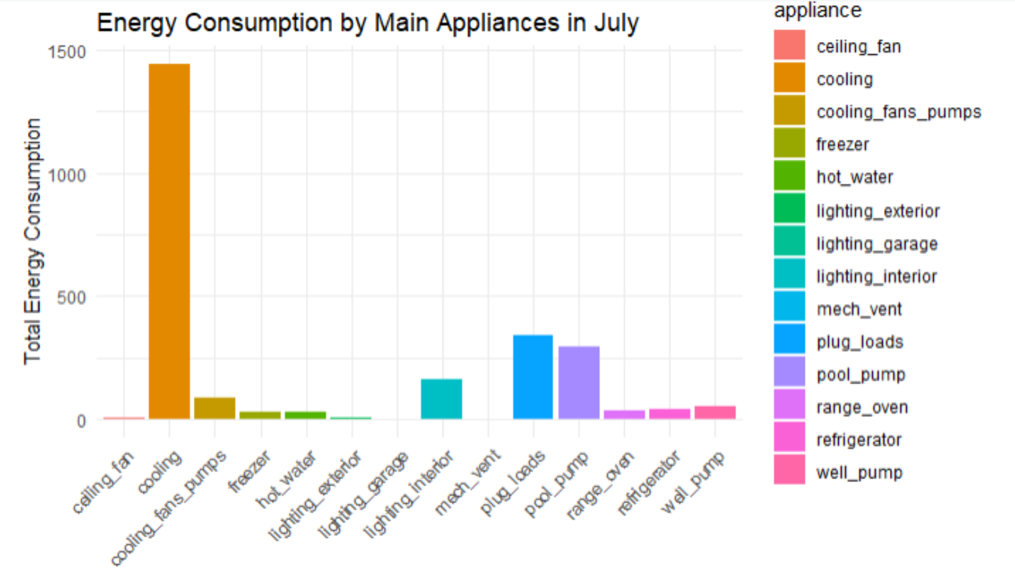
Energy Consumption by Appliances in July
The image shows the energy consumption by the main appliances in July.
The appliances that consume the most energy are air conditioners, refrigerators, and freezers.

Slide 9
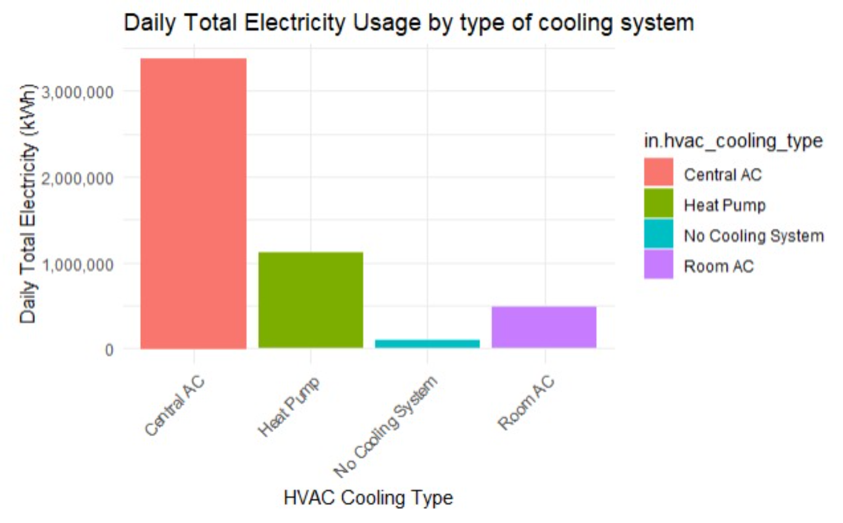
Total Electricity Usage by Cooling Systems
Central AC is the most common type of cooling system, accounting for over 60% of daily electricity usage.
Heat pumps are the second most common type of cooling system, accounting for over 20% of daily electricity usage.

Slide 10
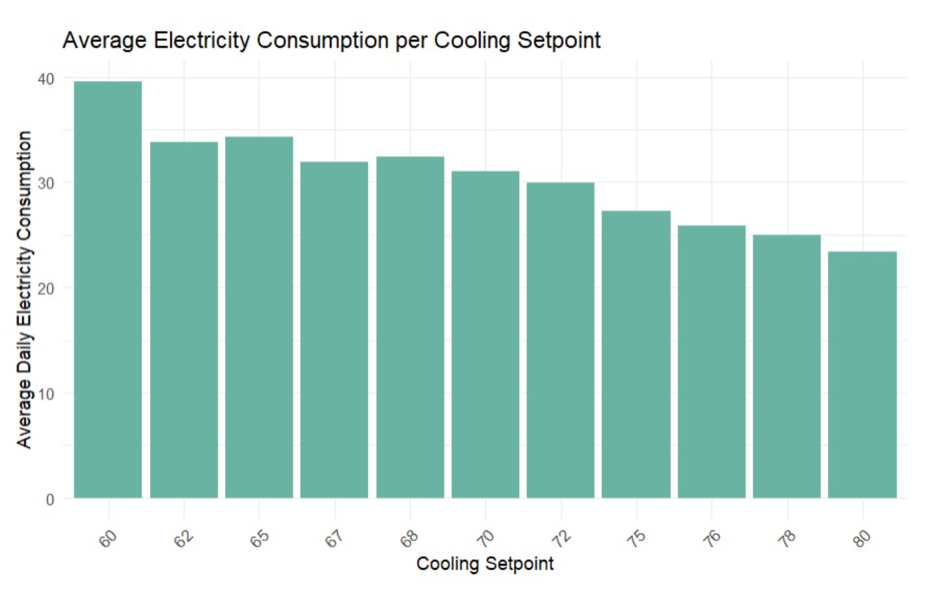
Average Electricity Consumption per Cooling Setpoint
The chart shows that there is a significant relationship between cooling setpoint and electricity consumption. For example, increasing the cooling setpoint from 72 degrees Fahrenheit to 75 degrees Fahrenheit can reduce electricity consumption by up to 20%.
This suggests that there is a significant opportunity to reduce electricity consumption and save money by raising the cooling setpoint.
The chart shows that there is a significant relationship between cooling setpoint and electricity consumption. For example, increasing the cooling setpoint from 72 degrees Fahrenheit to 75 degrees Fahrenheit can reduce electricity consumption by up to 20%.
This suggests that there is a significant opportunity to reduce electricity consumption and save money by raising the cooling setpoint.

Slide 11
THANKYOU

